Slide 1
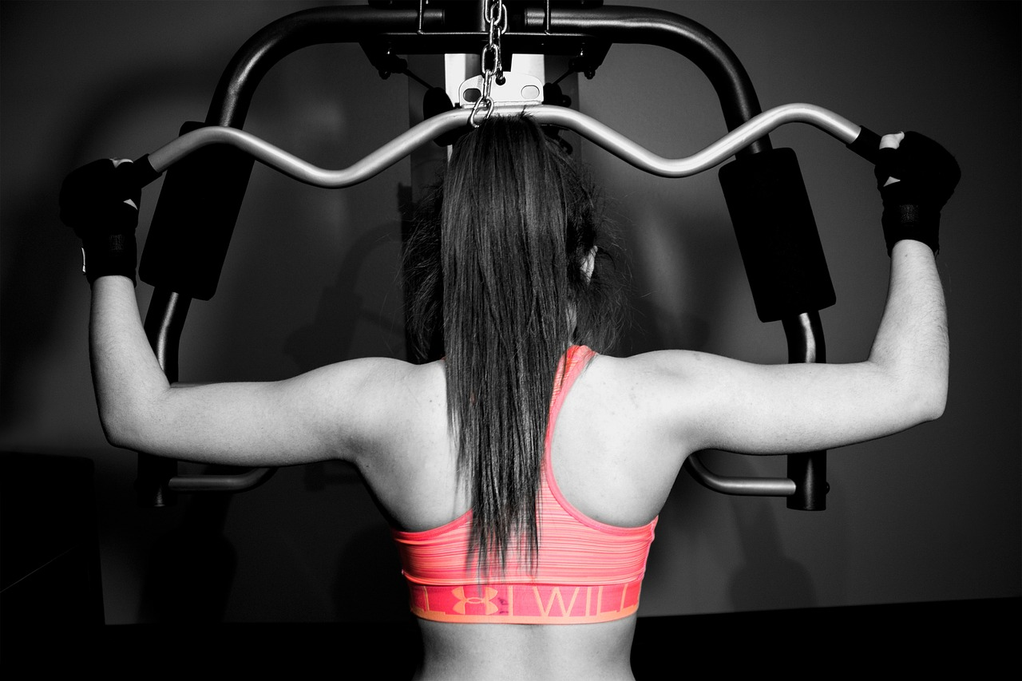
Work It Out
Login
About Us description
Sign up!

Slide 2
Work It Out
Login Signup
Name:
Email:
Password:
Submit

Slide 3
Work It Out
Login Signup
Email:
Password:
Don’t have an account? Sign up

Slide 4
Work It Out
Login Signup
What would you like to work out today?
Full Body
Lower Body
Upper

Slide 5
Work It Out
HI User!
Upper Body
Exercise | # of Reps | # of Sets
Name of Exercise 1 | 10 | 3
Name of Exercise 2 | 15 | 3
Name of Exercise 3 | 5 | 3
Name of Exercise 4 | 20 | 3

Slide 6
Work It Out
HI User!
Name of Exercise 1
Description about Exercise

